Slide 1
What is the best model to score the sentiment of movie reviews?
By Noel Mathew

Slide 2
Problem to Answer
Every time a movie comes out, there is always somebody reviewing it. Sometimes the movie could get great reviews. In other cases, the movie could be a flop and get bad reviews.
This project goal is to evaluate what type of model can predict a good review or a bad review the best.
In addition, this project will check if any of these words can show if a review is good or bad.

Slide 3
Who is my client
Review Sites Like Rotten Tomatoes
They can auto score reviews from many different sources from many sites and put them on their site
Movie Executives/Producers
Can find which movies had good reviews and bad reviews without hiring other resources to figure out which movies to make sequels of.
Actors/Directors
Can figure out which movies they performed well in.

Slide 4
Data that will be used
Movies reviews from IMDB
Movie ID
Review of the Movie
Sentiment Analysis score (0) for negative (1) for positive.
Data set that will be used
https://www.kaggle.com/c/word2vec-nlp-tutorial/data

Slide 5
Data Cleaning Steps
Get rid of non word text in the review
Remove HTML encodings using Beautiful Soup
Use an regex expression to get rid of non-words text
Split the review to separate words and lower case them
Remove any stop words
Add a clean review column in the csv file
Run each review through the steps above in the labeled data file
Append each clean review to a list
Make new clean review column and use the items in the list above as the values
Convert the Dataframe into a csv file with the new clean review file.

Slide 6
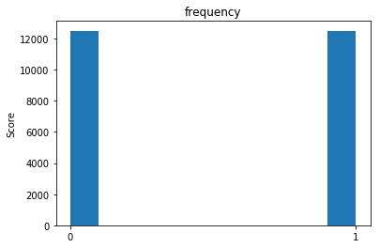
Data Story: Reviews and Scores
The positive and negative scores are evenly distributed

Slide 7
Data Story: Words affect scores
The next slides will show words and similar words and how distribution of scores are based on those words

Slide 8
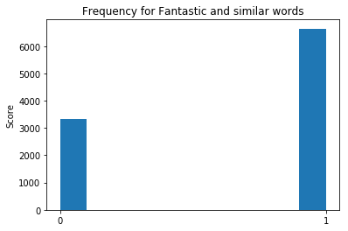

Slide 9
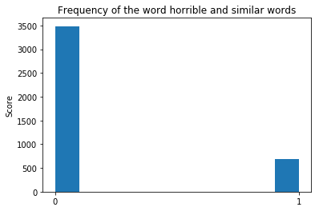

Slide 10
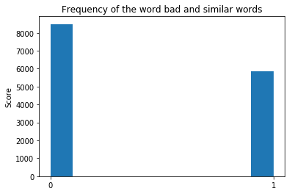

Slide 11
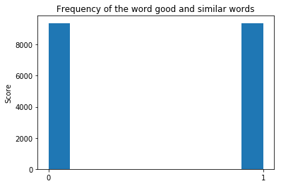

Slide 12
Statistical Analysis
Since these are unique reviews with words or text, it is not possible to do statistical analysis on the features which are the clean reviews.
The labels have a mean of 0.5 as the scores are evenly disturbed between negative (0) and positive (1).

Slide 13
Machine Learning
Feature Extraction/Encoding
The problem with modeling text is that is messy and machine learning algorithms prefer well defined fixed lengths inputs and outputs.
In addition, machine learning can not work raw text directly.
So need to transform words to numerical vectors
Two methods that are used to get vectors
Bag of Words
Word2Vec

Slide 14
Bag of Words
It counts the occurrence of words in text
Two Features
vocabulary of the known words – words in the reviews
count of the words – occurrence of said words
CountVectorizer.fit_transform
fits the model and learns the vocabulary
training data into feature vectors which counts the words in the review
Problems
Meaning issues
sparse vectors
Models used with BoW: Random Forest, Linear SVC, Naïve Bayes

Slide 15
Word2Vec
Word2vec is a two-layer neural net made by Google that processes text by “vectorizing” words.
Its input is a text corpus and its output is a set of vectors: feature vectors that represent words in that corpus.
Usefulness of Word2vec is to group the vectors of similar words together in a vectorspace.
Establishes a word’s association with other words or cluster documents and classify them by topic which is useful for sentiment analysis.
Vectors that are used to represent words are called neural word embeddings.
Used Gensim get_vector function and get the average vector of each review
Might affect the translation of the meaning of the review
Get rid of a lot of features
Models used – Random Forest, KNN, Linear SVC

Slide 16
Bag of Words Algorithms – Random Forest
Random Forest
Good in classifying data (binary classification problem)
Ensemble method that runs many trees
Accuracy score came out as 1.0 on the training set and 0.844 on the test set.
The F1 score was 0.85 on the negative score and 0.84 on the positive score
AUC of ROC was 0.92

Slide 17
Bag of Words Algorithms – Linear SVC
Linear SVC –
Good for text classification
Good for binary classification
Fast to run
Handle sparse vectors well
Accuracy score came out as 0.998 on the training set and 0.833 on the test set.
The F1 score was 0.85 on the negative score and 0.84 on the positive score
Hypertuning with GridSearchCV – C: 0.1, loss: squared_hinge
Accuracy score came out as 0.96 on the training set and 0.86 on the test set.
The F1 score was 0.86 on the negative score and 0.86 on the positive score

Slide 18
Bag of Words Algorithms – Naive Bayes
Naive Bayes–
Good for text classification
Assumption that words are independent from each other
Given a word what is the sentiment score
Accuracy score came out as 0.992 on the training set and 0.833 on the test set.
The F1 score was 0.83 on the negative score and 0.84 on the positive score
Hypertuning with GridSearchCV - best alpha: 50
Accuracy score came out as 0.876 on the training set and 0.853 on the test set.
AUC on the ROC was 0.92

Slide 19
Word2Vec Algorithms – Random Forest
Random Forest
Good in classifying data (binary classification problem)
Ensemble method that runs many trees
Accuracy score came out as 0.992 on the training set and 0.756 on the test set.
The F1 score was 0.77 on the negative score and 0.74 on the positive score
AUC of ROC was 0.83
Hypertuning with GridSearchCV – n_estimators: 300, min_samples_split: 5, max_depth: 60
Accuracy score came out as 1.000 on the training set and 0.824 on the test set.
The F1 score was 0.82 on the negative score and 0.83 on the positive score

Slide 20
Word2Vec Algorithms – Linear SVC
Linear SVC –
Good for text classification
Good for binary classification
Fast to run
Handle sparse vectors well
Accuracy score came out as 0.865 on the training set and 0.833 on the test set.
The F1 score was 0.86 on the negative score and 0.86 on the positive score
Hypertuning with GridSearchCV – C: 1, loss: squared_hinge
Default model so the same performance scores

Slide 21
Word2Vec Algorithms – KNN
KNN –
Can classify reviews by the reviews near it
Did nor perform better than the LinearSVC model

Slide 22
Tpot
Tpot, a Auto ML model, was used to find the best model to use with Word2Vec
After running tpot with 5 fold validation with a population size 10 and 5 generations, the best model it came up with during that time period was ExtraTreesClassifier on top of an LinearSVC.
The accuracy score came out as 0.878 on the training set and 0.856 on the test set.
The F1 score was 0.86 on the negative score and 0.86 on the positive score
The ROC curve was 0.92.

Slide 23
Overall Observations
Bag of Words model have overfitting issues
The best model to use LinearSVC
The reviews are linearly related to the sentiment
Probably handle a multitude of different features the best
Handle the sparse features well too

Slide 24
Usefulness of the Project
Can help movie review sites like Rotten Tomatoes run different Linear SVC models to find reviews online on forums like reddit and label them positive or negative with roughly 87% accuracy.
Likewise movie executives and producers can find reviews online about their movies and be 87% sure which movie was a hit.
This can help movie related companies save time, money, and resources by not having people manually reading each review and labelling them as positive or negative.

Slide 25
Improvements
Keras model
Different reviews from different sites to go along with IMDB reviews.
More hyperparameter tuning
Tpot could have been run longer to possibly find a better model.

Slide 26
END

